Slide 1

Professional Practices (HUM-305)
SPRING SEMESTER 2026
By
Prof Engr Muhammad Raheel Iqbal Butt
Resource Person
Contact: +92 321 7433568
School of Computer & Information Technology
Beaconhouse National University, Lahore

Slide 2
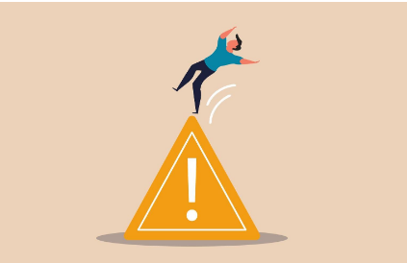

Slide 3
Chap 8 Errors, Failures, And Risks
Failures and Errors in Computer Systems
Problems for Individuals
System Failures
What Goes Wrong?
So Why Software and Design Problems
Many Incidents?
Observations and Perspective
Increasing Reliability and Safety
Professional Techniques
Trust the Human or the Computer System?
Law, Regulation, and Markets
Dependence, Risk, and Progress

Slide 4
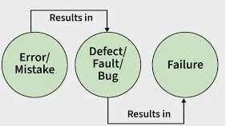

Slide 5
Failures and Errors in Computer Systems
1. Failures and Errors in Computer Systems
Failures occur due to hardware faults, software bugs, or human errors
Can be temporary (glitches) or permanent (system crash)
Example: A banking app crash during peak hours prevents transactions
Example: Software bug causing incorrect calculations (e.g., billing errors)
Critical systems (healthcare, aviation) require near-zero failure tolerance
2. Problems for Individuals
Financial loss: Incorrect bank transfers or duplicate transactions
Privacy breach: Personal data leaks from hacked systems
Identity theft: Stolen credentials used for fraud
Emotional stress: Losing important files or facing service downtime
Example: Social media account hacked → misuse of personal identit

Slide 6
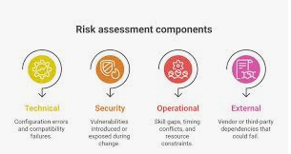

Slide 7
System Failures
3. System Failures
Complete failure: Entire system stops (e.g., server crash)
Partial failure: Some features stop working (e.g., payment gateway down)
Network failure: Internet outage disrupts communication
Example: Airline reservation system crash → flight delays worldwide
Example: Hospital system failure delaying patient treatment
4. What Goes Wrong?
Software bugs: Coding mistakes or logic errors
Hardware issues: Disk failure, overheating
Human error: Wrong configuration or accidental deletion
Poor testing: Bugs not detected before deployment
Example: Wrong database update deleting user records

Slide 8
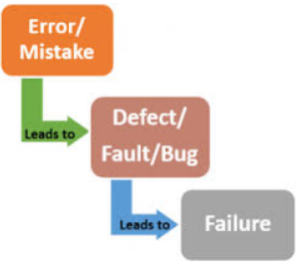

Slide 9
So Why Software and Design Problems?
5. So Why Software and Design Problems?
System complexity: Millions of lines of code
Time pressure: Deadlines reduce quality checks
Poor requirements: Misunderstanding user needs
Lack of expertise: Inexperienced developers
Example: A rushed update causes app crashes after release
6. Many Incidents?
Frequent failures in banking systems, airlines, telecom networks
Example: ATM network outage → customers unable to withdraw cash
Example: Website downtime during big sales (e.g., e-commerce crash)
Cyberattacks exploiting system weaknesses
Shows that failures are common even in advanced systems

Slide 10
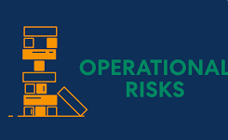

Slide 11
Observations and Perspective
7. Observations and Perspective
No system is 100% error-free
Failures help improve future system design
Technology evolves through trial and correction
Example: Early software versions often unstable, later improved
Need for balance between innovation and reliability
8. Increasing Reliability and Safety
Testing: Unit testing, integration testing, system testing
Backup systems: Data recovery mechanisms
Redundancy: Multiple systems to prevent total failure
Monitoring: Real-time alerts for issues
Example: Cloud services using backup servers to avoid downtime

Slide 12
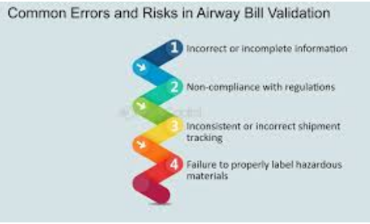

Slide 13
Professional Techniques
9. Professional Techniques
Code reviews: Team checks each other’s work
Version control: Track changes (e.g., Git)
Documentation: Clear system design and instructions
Ethics: Avoid shortcuts that risk safety
Example: Following software engineering standards to prevent bugs
10. Trust the Human or the Computer System?
Humans: Creative but error-prone
Computers: Accurate but lack judgment
Best approach: Human + system collaboration
Example: Pilots rely on autopilot but can override in emergencies
Example: Doctors use software but make final decisions

Slide 14
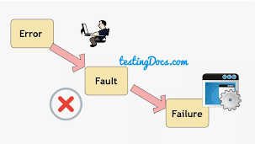

Slide 15
Law, Regulation, and Markets
11. Law, Regulation, and Markets
Governments enforce data protection laws
Companies must ensure user safety and privacy
Regulations create accountability
Example: Companies fined for data breaches
Market competition encourages better quality systems
12. Dependence, Risk, and Progress
Society depends on technology for daily life
More dependence → higher risks if systems fail
Example: Internet outage affecting businesses, education, banking
Continuous improvement leads to technological progress
Need to manage risks while embracing innovation

Slide 16


Slide 17


